Slide 1
The Dynamics of Innovation: From National Systems and “Mode 2” to a Triple Helix of University-Industry-Government Relations.
2022 Fall. National Innovation System
W11. Universities in Innovation
By H. Etzkowitz, and L. Leydesdorff (2000)
Hyeonbin Park
November 8, 2022

Slide 2
Table of Contents
Author Introduction
What is a Triple Helix?
Characteristics of the Triple Helix
Implications of the Triple Helix
1

Slide 3
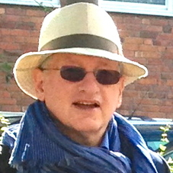

1. Author Introduction
Henry Etzkowitz
Sociologist, STS, Innovation Studies
“Entrepreneurial University” and “Triple Helix” concepts.
Founding President of the Triple Helix Association & Co-Founder of the International Triple Helix Institute in Silicon Valley
Loet Leydesdorff
Sociologist, Professor in the Dynamics of Scientific Communication and Technological Innovation at the Amsterdam School of Communications Research (ASCoR) of the University of Amsterdam
Systems theory, social network analysis, scientometrics, and the sociology of innovation
2

Slide 4
2. What is a Triple Helix?
Triple Helix of University-Industry-Government Relations
The university can play an enhanced role in innovation in increasingly knowledge-based societies in the complex relationships between universities, industries, and governments.
Analytically different from the national systems of innovation (NSI) approach (Lundvall, 1988, 1992; Nelson, 1993)
The firm is an actor as having the leading role in innovation
different from the ‘‘Triangle’’ model of Sabato (1975)
The state is privileged
3

Slide 5
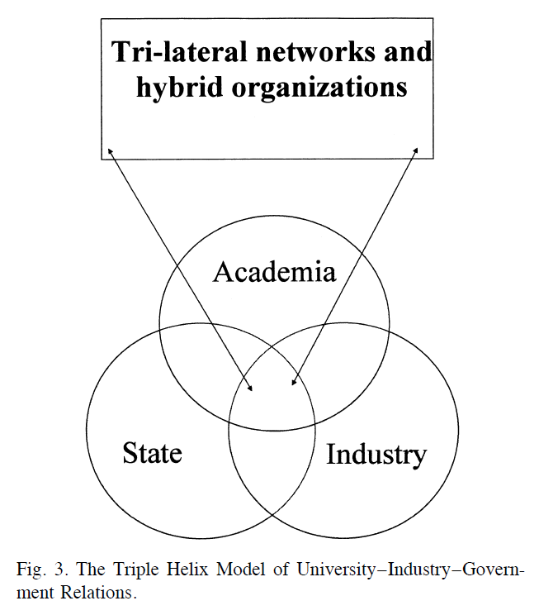
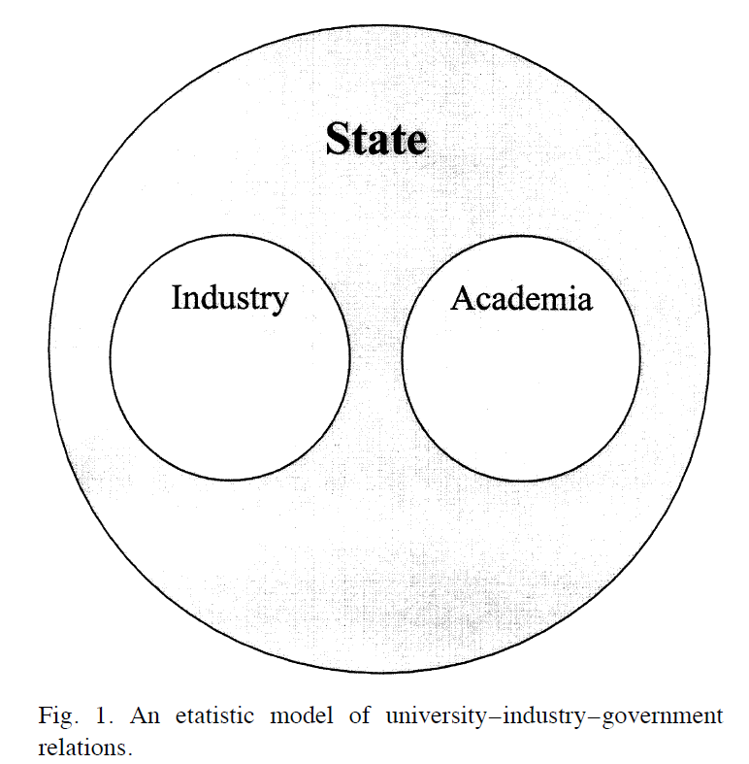
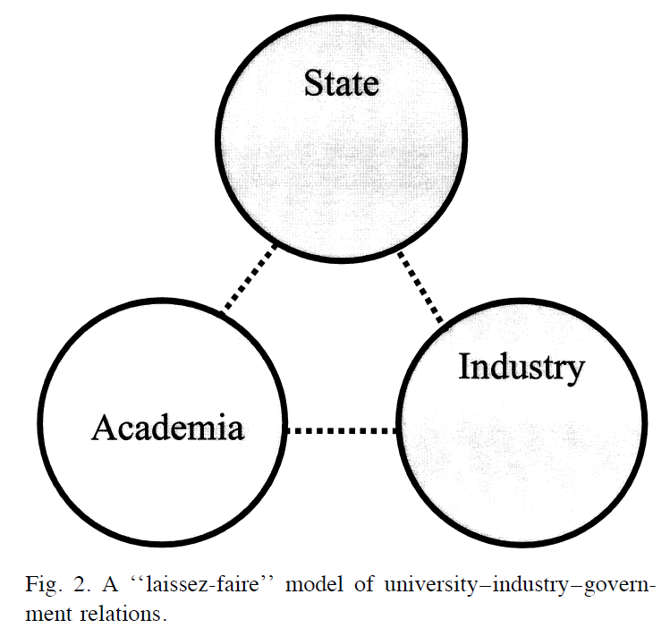
2. What is a Triple Helix?
The configuration of Triple Helix
4

Slide 6
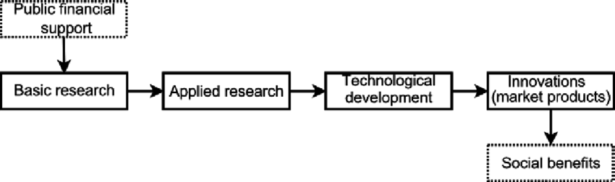
2. What is a Triple Helix?
From “endless frontier”
V. Bush (1945)’s Linear Model of Innovation
5

Slide 7
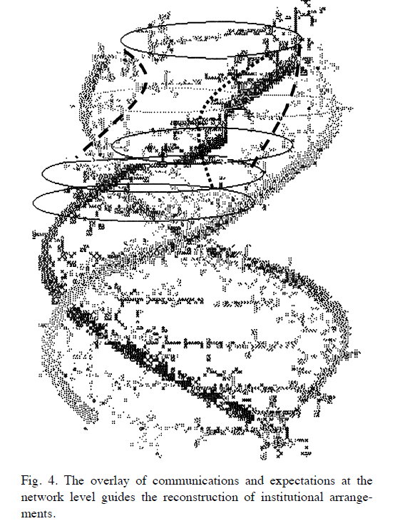
2. What is a Triple Helix?
To “endless transition”
Basic research is linked to utilization through a series of intermediate processes (Callon, 1998), often stimulated by the government.
6

Slide 8
3. Characteristics of the Triple Helix
A Triple Helix is not expected to be stable.
This network of relations generates a reflexive subdynamics of intentions, strategies, and projects that adds surplus value by reorganizing and harmonizing continuously the underlying infrastructure in order to achieve at least an approximation of the goals
An endless transition
Complex system is developed that is continuously integrated and differentiated, both locally and globally
The dynamics are nonlinear while both the interaction terms and the recursive terms have to be declared
7

Slide 9
4. Implications of the Triple Helix
First, the arrangements between industry and government no longer need to be conceptualized as exclusively between national governments and specific industrial sectors.
Second, the driving force of the interactions can be specified as the expectation of profits.
8

Slide 10
4. Implications of the Triple Helix
Third, the foundation of the model in terms of expectations leaves room for uncertainties and chance processes.
Fourth, the expansion of the higher-education and academic-research sector has provided society with a realm in which different representations can be enter- tained and recombined in a systematic manner. -> beyond profit maximization
9

Slide 11
4. Implications of the Triple Helix
Fifth, the model also explains why the tensions need not to be resolved. A resolution would hinder the dynamics of a system which lives from the perturbations and interactions among its subsystems.
Sixth, the crucial question of the exchange media — economic expectations (in terms of profit and growth), theoretical expectations, assessment of what can be realized given institutional and geographic constraints — have to be related and converted into one another. The helices communicate recursively over time in terms of each one’s own code.
10

Slide 12
5. Discussion
11

Slide 13
Thank you ☺
2022 Fall. National Innovation System
W11. Universities in Innovation
Hyeonbin Park
November 8, 2022

